Slide 1
Course Code:CSC402A Course Title: Web Architecture and Application Development
Course Leader:
Kishore S.M.
kishore.cs.et@msruas.ac.in

Slide 2
Objectives
After completing this lecture, the student will be able to
Describe Middleware
Describe message oriented middleware
Analyze Java messaging service

Slide 3
Contents
Middleware
Message Oriented middleware (MOM)
Java Messaging Service

Slide 4
Middleware
Applications
Application components
Middleware
Operating system
Network

Slide 5
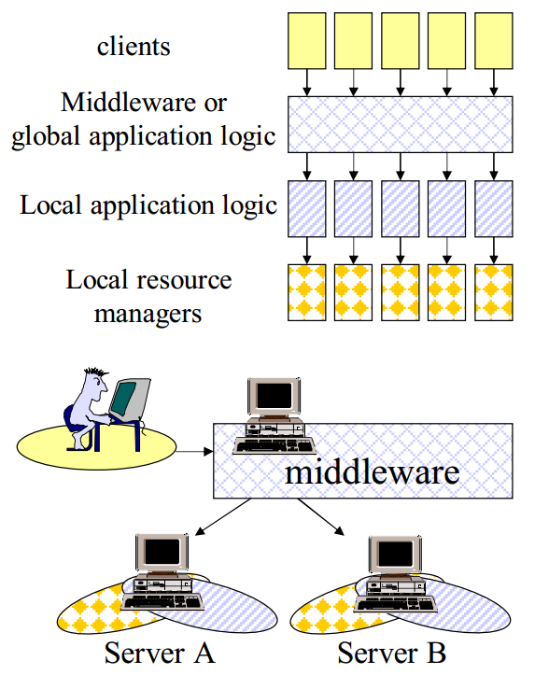
Middleware

Slide 6
Functionality of Middleware
It introduces an additional layer of business logic encompassing all underlying systems
By doing this, a middleware system:
Simplifies the design of the clients by reducing the number of interfaces
Provides transparent access to the underlying systems
Acts as the platform for intersystem functionality and high level application logic
Takes care of locating resources, accessing them, and gathering results

Slide 7
Types of Middleware
RPC-based systems
TP monitors
Object brokers
Object monitors
Message oriented middleware
Message brokers

Slide 8
Message Oriented Middleware (MOM)
MOM is a software that resides in both portions of client/server architecture and typically supports asynchronous calls between the client and server applications
Data is transferred between applications as a message
App-1
Queue
App-2

Slide 9
Message Oriented Middleware (MOM)
Basic Components of MOM
Message
Information that needs to be transferred
Provide temporary storage when the destination program is busy or not connected
Queue
A container used to store and distribute messages
MOM systems provide persistent storage to back up the message queue

Slide 10
Message Oriented Middleware (MOM)
Mode Of Communication
Asynchronous
MOM comprises a category of inter-application communication software that generally relies on asynchronous message-passing
Products
IBM WebSphere MQ
TIBCO Rendezvous
MSMQ from Microsoft
Emerging standards specifications such as JMS and WS-Reliable Messaging

Slide 11
Publish/Subscribe
A service publishes messages/events of given type
Clients subscribe to different types of messages/events
When a service publishes an event, the system looks at a table of subscriptions and forwards the event to the interested clients
Usually done in the form of a message put into a queue for that client

Slide 12
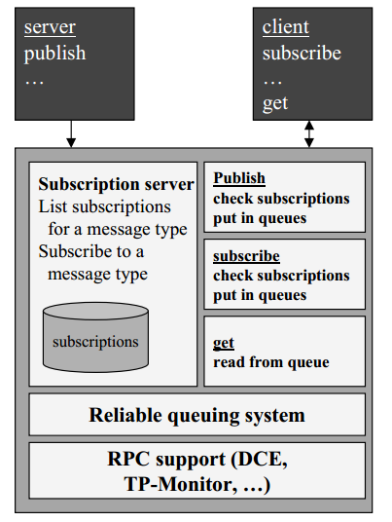
Publish/Subscribe

Slide 13
Advantages of MOM
Ability to store, route or transform messages in the process of delivery
Flexibility
More dynamic
APIs that extend across diverse platforms and networks are typically provided by MOM
Reduces the involvement of application developers

Slide 14
Disadvantages of MOM
Require an extra component in the architecture, the message transfer agent (message broker)
As with any system, adding another component can lead to
Reductions in performance and reliability
Make the system as a whole more difficult and expensive to maintain
Many inter-application communications have an intrinsically synchronous aspect
Lack of standards
All the major vendors have their own implementations, each with its own application programming interface (API) and management tools
JMS, which is implemented by most MOM vendors and aims to hide the particular MOM API implementations

Slide 15
Java Message Service (JMS) API
API allowing the developer to create, send, receive and read messages
Part of the JEE, and is defined by a specification developed under the Java Community Process as JSR 914
It allows the communication between different components of a distributed application to be loosely coupled, reliable, and asynchronous
Guarantees that the message is received just once, even though the recipient is not available at the moment the message was sent
Both the sender and the recipient need to know only the message format and the message destination used

Slide 16
JMS Elements
JMS provider
An implementation of the JMS interface for a Message Oriented Middleware (MOM)
JMS client
An application or process that produces and/or receives messages
JMS producer/publisher
A JMS client that creates and sends messages
JMS consumer/subscriber
A JMS client that receives messages

Slide 17
JMS Elements contd.
JMS message
An object that contains the data being transferred between JMS clients
JMS queue
A staging area that contains messages that have been sent and are waiting to be read (by only one consumer)
Contrary to what the name queue suggests, messages don't have to be delivered in the order sent
A JMS queue only guarantees that each message is processed only once
JMS topic
A distribution mechanism for publishing messages that are delivered to multiple subscribers

Slide 18
Models
The JMS API supports two models
Point-to-point
Publish and subscribe

Slide 19
Point-to-point model
Messages are routed to an individual consumer which maintains a queue of "incoming" messages
Built on the concept of message queues, senders, and receivers
Each message is addressed to a specific queue
The receiving clients extract messages from the queues established to hold their messages
Any number of producers can send messages to the queue
Each message is guaranteed to be delivered, and consumed by one consumer
Queues retain all messages sent to them until the messages are consumed or until the messages expire
If no consumers are registered to consume the messages, the queue holds them until a consumer registers to consume them

Slide 20
Publish/subscribe Model
Supports publishing messages to a particular message topic
Subscribers may register interest in receiving messages on a particular message topic
Neither the publisher nor the subscriber knows about each other
Zero or more consumers will receive the message
The same Java classes can be used to communicate with different JMS providers by using the JNDI information for the desired provider
The classes first use a connection factory to connect to the queue or topic, and then use populate and send or publish the messages
On the receiving side, the clients receive or subscribe to the messages

Slide 21
Summary
MOM is a software that resides in both portions of client/server architecture
JMS is the API allowing the developer to create, send, receive and read messages

